Slide 1
Exothermic and Endothermic Reactions

Slide 2
Energy and Chemical Reactions
Chemical Energy – Energy stored in the chemical bonds of a substance.
Chemical reactions always involve energy changes.
Making bonds and breaking bonds involve energy changes

Slide 3
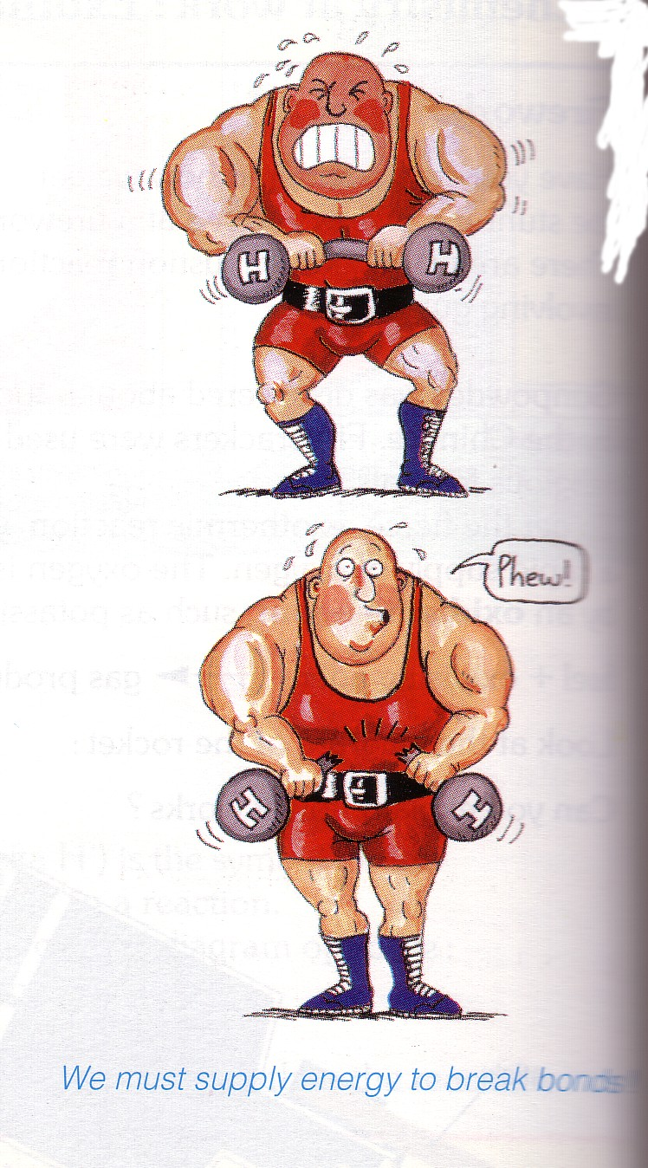
Activation Energy
The energy required to break the bonds in the reactants for a chemical reaction to occur.

Slide 4
Endothermic and Exothermic reactions
Step 1: Energy must be SUPPLIED to break chemical bonds of reactants:
Step 2: Energy is RELEASED when new chemical bonds are made in the products:
A reaction is EXOTHERMIC if more energy is RELEASED than SUPPLIED. If more energy is SUPPLIED than is RELEASED then the reaction is ENDOTHERMIC
© Teachable . Some rights reserved. http://teachable.net/res.asp?r=1910

Slide 5


Energy of Chemical Reactions
Based on the type of energy (heat) change involved, chemical reactions are classified as either exothermic or endothermic.
  Exothermic: energy is released
    Exo- = “exit”
    Burning of gasoline
  Endothermic: energy is absorbed
    Endo- = “into”
    Cooking of pancakes

Slide 6
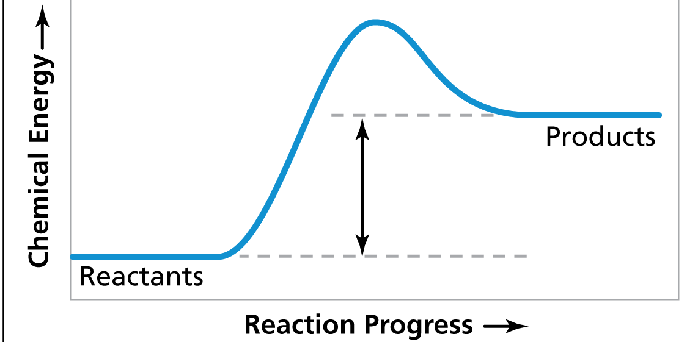
Endothermic Diagram
Energy released in bond making
Activation
Energy
Energy used in bond
breaking
Energy absorbed in reaction
Endothermic – more energy is taken in to break the bonds in the reactants than released by the bonds being formed in the products. Therefore, energy is absorbed.

Slide 7
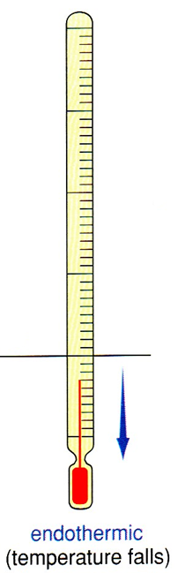
Endothermic
Heat (energy) taken in
Temperature of the substance drops
Products feel COLD
reaction

Slide 8
Endothermic Reactions
You may see an endothermic reaction written like this…
REACTANTS + ENERGY PRODUCTS
OR
REACTANTS + HEAT PRODUCTS

Slide 9
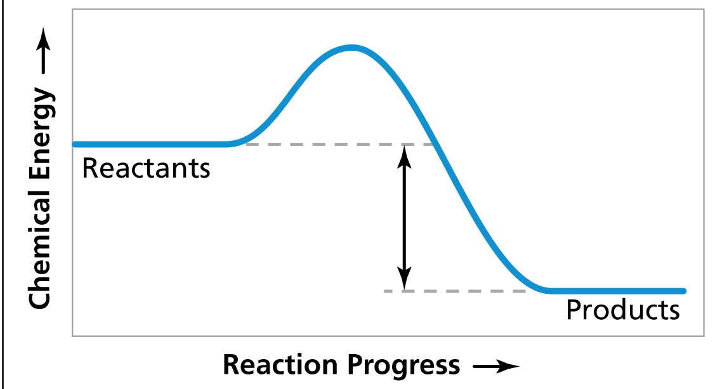
Exothermic Diagram
Activation Energy
Energy used in bond
breaking
Energy released in bond making
Exothermic – More energy is released when the products where formed than energy was used to break bonds in the reactants. Therefore, a net release of energy.

Slide 10
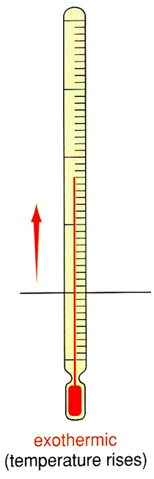
Exothermic
Heat (energy) given off
Temperature of the substance rises
Products feel HOT
reaction

Slide 11
Exothermic Reactions
You may see an exothermic reaction written like this…
REACTANTS PRODUCTS + ENERGY
OR
REACTANTS PRODUCTS + HEAT

Slide 12
ENDOTHERMIC OR EXOTHERMIC?
6CO₂ + 6H₂O + Energy C₆H₁₂O₆ + 6O₂
ENDOTHERMIC!
CH₄ + 2O₂ CO₂ + 2H₂O + Energy
EXOTHERMIC!

Slide 13
Examples
Exothermic
Combustion of fuels
Yeast & Hydrogen Peroxide
Epson salts & water
Endothermic
Photosynthesis
Acedic Acid & Sodium Bicarbonate
© Teachable . Some rights reserved. http://teachable.net/res.asp?r=1910

